Slide 1
Software Engineering: Concepts and Methods
Week 5
The Requirements Stage

Slide 2
Learning Objectives
Understand different types of requirements and be able to distinguish them
Understand the importance of the requirements stage
Understand processes involved in requirements engineering

Slide 3
Contents of the Lecture
Importance of the requirements stage
What are requirements?
Types of Requirements
Requirements Engineering
Overall Description of Software Specification based on an International Standard
Conclusions

Slide 4
How it goes wrong
Requirements | good set of requirements | bad set of requirements
Design | good design | good design | poor design
Implementation | good product | good product | good product | bad product
Testing | bug free | bug free | bug free | bug free | buggy
Result | what they wanted | product that nobody wants | poorly designed product that nobody wants | poorly designed bad product that nobody wants | Windows Vista
Notes:
read downwards
as soon as the requirements are wrong you can’t end up with something good

Slide 5
Cost of repair
Stage problems are found | Relative cost to repair
Requirements | 0.1 - 0.2
Design | 0.2 - 1.0
Implementation | 1.0 - 2.0
Testing | 2.0 - 5.0
After release | > 5.0

Slide 6
Difficulties at the Requirements Stage
It is difficult for people to describe, visualise and understand a system in words and cannot demonstrate the working of a live system.
Not able to represent and take into consideration human factor issues involved in using the system. i.e.. User interfaces.
The user and developer interpret words differently, technical computer terms are used in the requirement documents and customers find it difficult to understand and give feedback.
Changes in requirements

Slide 7
Cost (effort) to Repair Software in Relationship to Life Cycle Stage
Stage Relative Cost of Repair
Requirements 0.1 - 0.2
Design 0.5
Implementation 1
Unit Test 2
Acceptance Test 5
Maintenance 20

Slide 8
What are requirements?
The requirements for a system are the descriptions of the services that a system should provide and the constraints on its operations.
These requirements reflect the needs of customers for a system that serves a certain purpose, e.g. placing an order.

Slide 9
What are requirements? (2)
The term requirement is not used consistently in the software industry.
In some cases, a requirement is a high-level, abstract statement of a service that a system should provide or a constraint on a system. In some other cases, it is a detailed, formal definition of a system function.
In addition, the following two terms are used interchangeably: requirements definition and requirements specification.

Slide 10
What are requirements? (3)
Requirements Definition
is a complete list of
everything the customer
expects the proposed
system to do.
It represents an understanding
between stakeholders of what
the customers/users needs or wants
Requirements Specification
restates the requirements definition
in technical terms appropriate for the
development of a system design.
It is a technical counterpart to the
Requirements Definition Document.
User Requirements
are statements, in natural language
plus diagrams, of what services the
system is expected to provide to
system users and the constraints
under which it must operate.
System requirements
are more detailed descriptions of the
software system's functions, services, and operational constraints. System requirements document should define exactly what is to be implemented. It may be the part of the contract between the system buyer and the software developers.

Slide 11
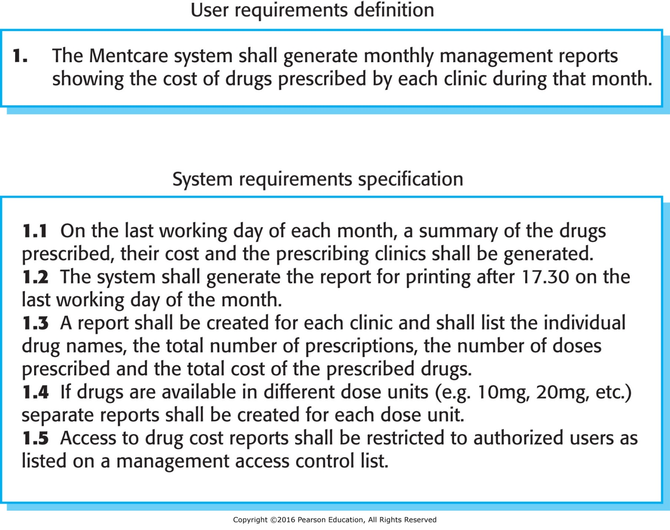
What are requirements? (4)

Slide 12
Types of Requirements
There are two types of requirements:
functional
non-functional
Functional requirements are statements of services the system should provide, how the system should react to particular inputs, and how the system should behave in particular situations. In some cases, the functional requirements may also explicitly state what the system should not do. They describe the nature of the interaction between the component and its environment (i.e. WHAT the system will do!).
Non-functional requirements are constraints on the services or functions offered by the system. They include timing constraints, constraints on the development process, and constraints imposed by standards. Non-functional requirements often apply to the system as a whole rather than individual system features.

Slide 13
Examples: Functional Requirements
The system will continuously display the temperatures of all the machines.
The system will display the titles of all the books written by the specified author.
When a book becomes overdue, the system should display appropriate information.
A user should be able to search the appointments lists for all clients.
Each staff member using the system shall be uniquely identified by his or her eight-digit employee number.
The system shall generate each day, for each clinic, a list of patients who are expected to attend appointments that day.

Slide 14
Non-functional Requirements
Non-functional requirements are often more critical than individual requirements.
Failing to meet a non-functional requirement can mean that the whole system is unusable.
While it is often possible to identify which system components implement specific requirements, this is often more difficult with non-functional requirements.
Non-functional requirements arise through user needs because of (refer to the following figure):

Slide 15
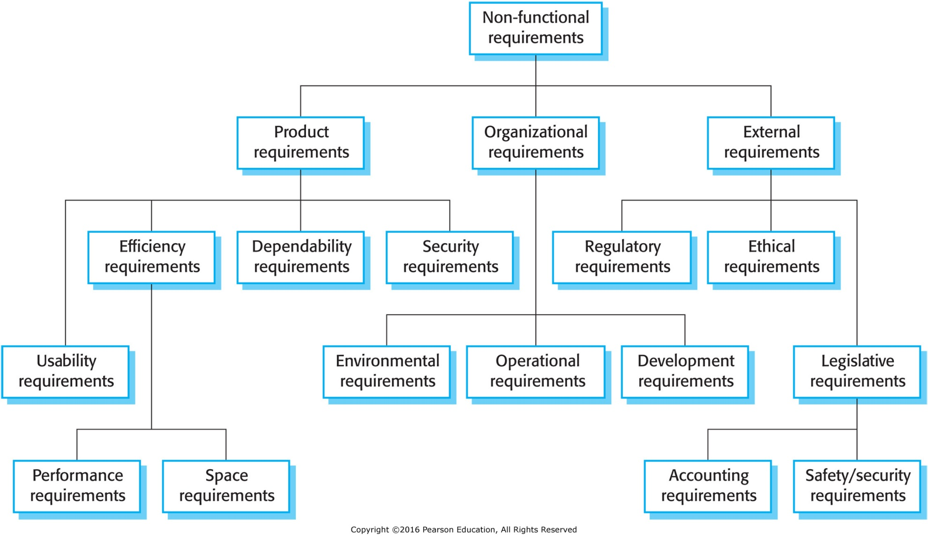
Non-functional Requirements (2)

Slide 16
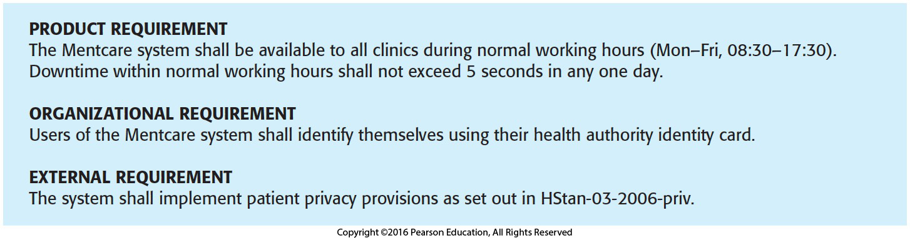
Examples: Non-functional requirements
The software must run on a standard PC with 2 TB hard disk.
The commands should be accessible via cursor selection
from a menu.
The computer must respond within 1 second to any request.
Customers' data should be protected in accordance with Data Protection Act 2018.

Slide 17
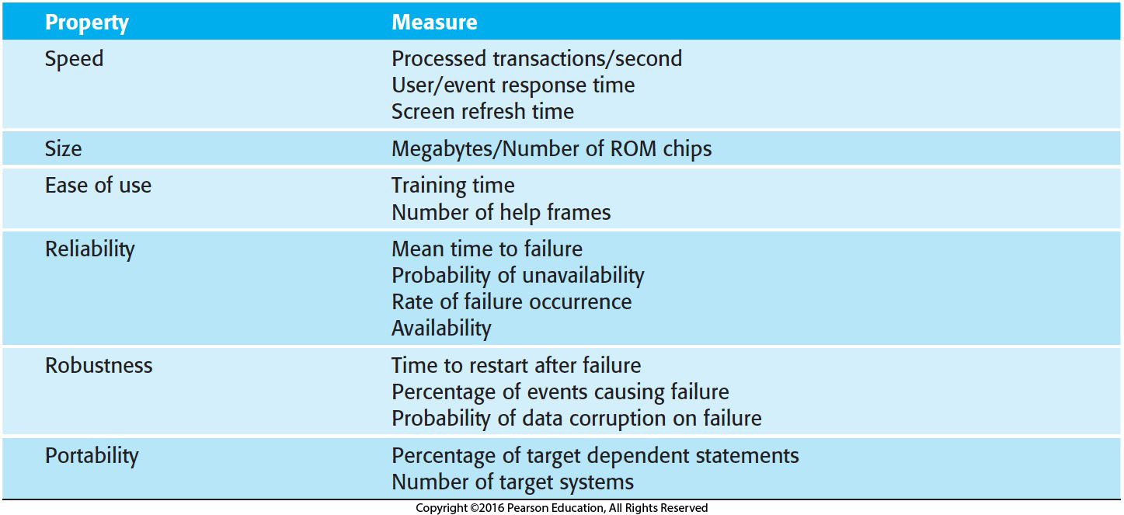
Metrics for Specifying Non-Functional Requirements

Slide 18
Requirements Engineering
Requirements engineering is the process of finding out, analysing, documenting and checking services that a software system should provide along with its constraints.
Requirements Engineering can be viewed as a process the aim of which is to change the initial input into the desired output.
Requirements Engineering
inputs: individual views of the system
output: a complete unambiguous specification of the system
agreed by all participants

Slide 19
The Three Dimensions of the Requirements Engineering Process
Specification
desired
output
complete
Agreement
common
view
fair
input
personal view
Representation
informal
semi-formal
formal

Slide 20
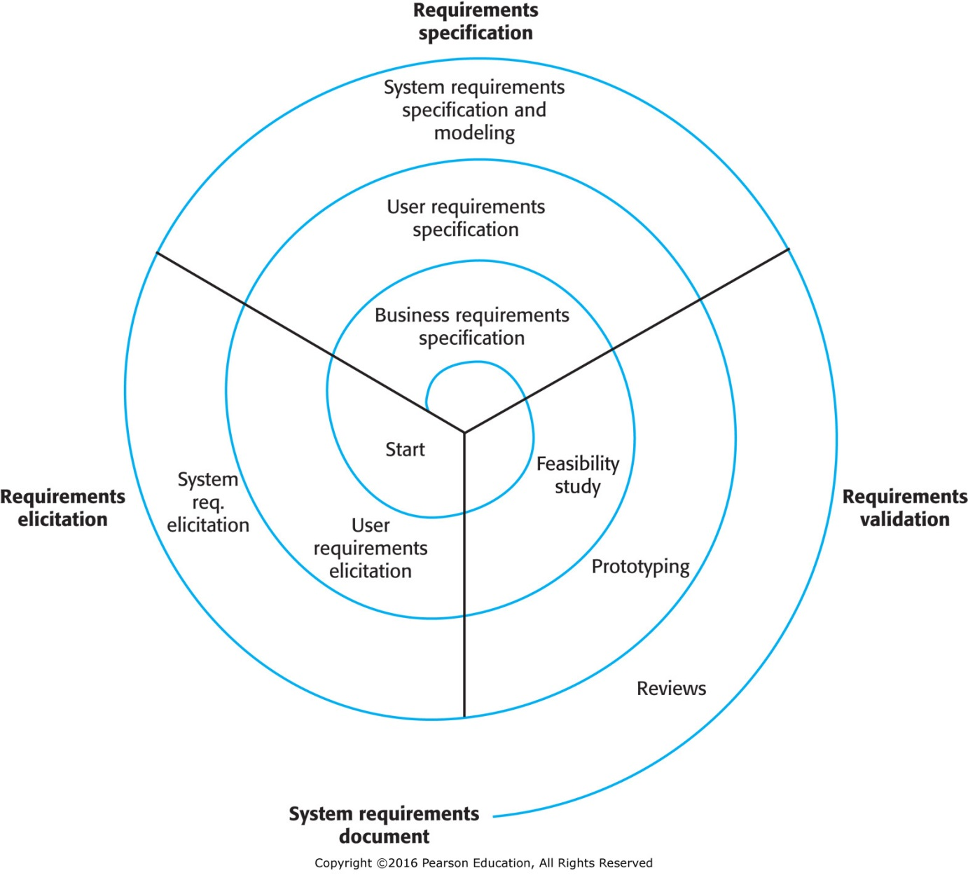
A Spiral View Of Requirements Engineering Process

Slide 21
A Framework for Requirements Engineering
Feedback
User
User
Requirements
Models to be
validated
Requirements
Models
Knowledge
Elicitation
Specification
Validation
Request more
Knowledge
Validation
Outcome
Domain
Knowledge
Domain
Knowledge
Problem
Domain

Slide 22
Writing a Software Requirements Specification
An SRS is a description of a particular software product, program or set of programs that performs a set of functions in a target environment (IEEE Std. 830-1984/1998.) The basic issues that the SRS write(s) shall address are the following:
Functionality. (what is the S/W supposed to do?)
External interfaces. (how does the S/W interact with people, the system’s hardware, and other S/W)
Performance. (what is the speed, availability, response time, recovery time of various S/W functions, etc.)
Attributes- Quality factors (what are the portability, correctness, maintainability, security, etc. considerations?)
Design constraints imposed on an implementation (are there any required standards in effect, implementation language, policies for database integrity, resource limits, operating environment(s), etc?)

Slide 23
Parts of SRS
Table of Contents
1. Introduction 3. Specific Requirements
1.1 Purpose (external interfaces, process and data
1.2 Scope requirements, performance and quality
1.3 Definitions requirements, logical database requirements,
1.4 References design constraints, s/w system attributes,
1.5 Overview organising specific requirements)
2. Overall description Appendices
2.1 Product perspective Index
2.2 Product functions
2.3 User characteristics
2.4 Constraints
2.5 Assumptions and dependencies
regularity policies
hardware limitations
interfaces to other applications
safety and security profile
reliability requirements, etc.

Slide 24
Overall Description of SRS
Section Topic Content
2.1 Product perspective States if product self-contained,
independent, or if product is part of
a larger system
2.2 Product functions Describes major functions S/W will
perform
2.3 User characteristics Indicates intended users of product,
and education level, experience,
technical expertise required by users
2.4 Constraints General description of any items
that will limit a developer’s options in
producing S/w
2.5 Assumptions and Factors that can affect the SRS,
dependencies and assumptions about S/W

Slide 25
Requirements Change and Management
There may be a number of reasons for changing requirements. These include:
problems may not be defined completely at the beginning;
during the course of the software development process, the stakeholders' understanding/perception of the problem often changes;
changes to the business environment of the system take place (e.g. introduction of new hardware/software, changes in business priorities, new legislation, changes in user stakeholders, emerging conflicts and/or priorities among user stakeholders, etc.)

Slide 26
Requirements Change and Management (2)
Issues involved in the requirements management planning are:
requirements identification (cross referencing with other requirements for traceability- backward and forward)
a change management process (assessment of impact and cost)
Traceability policies
Tool support

Slide 27
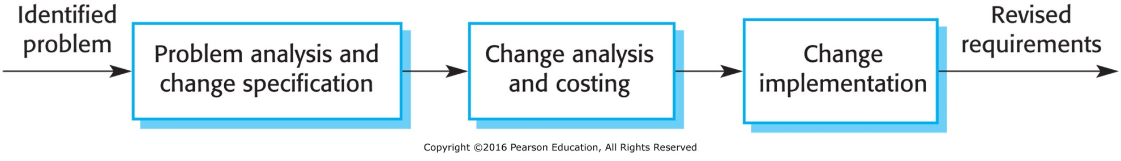
Requirements Change and Management (3)

Slide 28
Conclusions
Requirements for a software system define what the system should do and set out constraints on its operations and implementation.
The requirements engineering process includes requirements elicitation, requirements specification, requirements validation and requirements management.
Requirements specification is the process of formally documenting software requirements.
Business, organisational and technical changes inevitably lead to changes to requirements for a software system, which should be managed rigorously.

